Slide 1
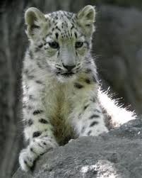
A presintation about snow leopards

Slide 2
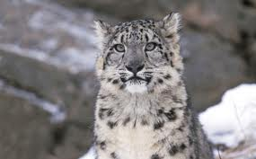
Me and Brendon chose the snow leopard

Slide 3
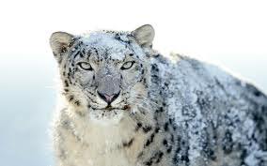
Facts about the snow leopard.
Snow leopards are on the endangered list.
Also known as Uncia uncia.
They are carnivores.
Feline.
Size: tail 80-100 centametres.
male weight 45-55 kg.
femail weight 35-40 kg.

Slide 4
The end of this presentation
The end the end the end the end the end the end the end the end the end the end the end the end the end the end the end the end the end the end the end the end the end the end the end ttttthhhhhhheeeeeee eeeeeennnnnndddd

